Slide 1
Weeks 7&8 Exercise
Andrea Fox
January 31, 2021
DSC640 – T301 – Data Presentation & Visualization

Slide 2
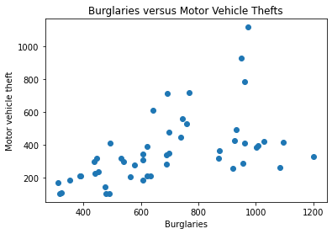
Python – Scatter Plot

Slide 3
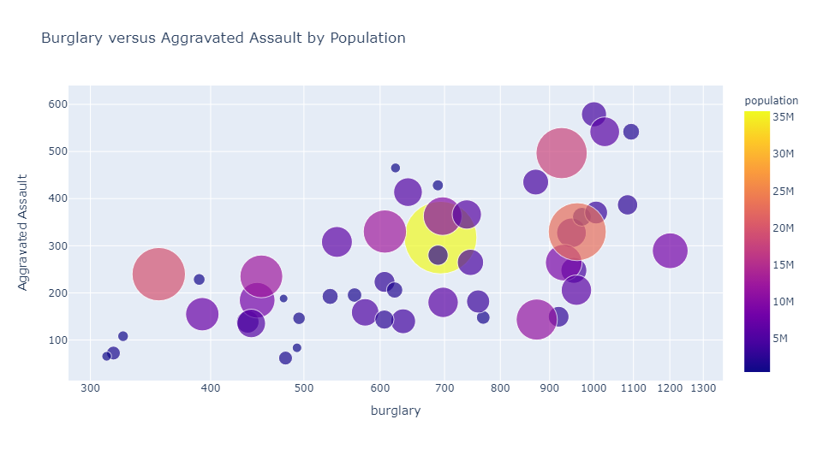
Python – Bubble Plot

Slide 4
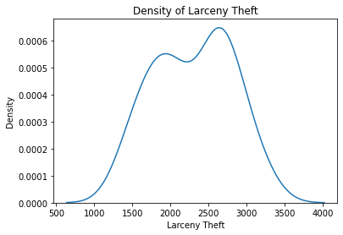
Python – Density Plot

Slide 5
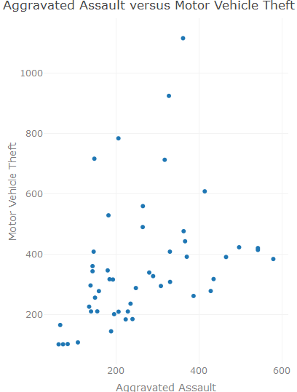
R – Scatter Plot

Slide 6
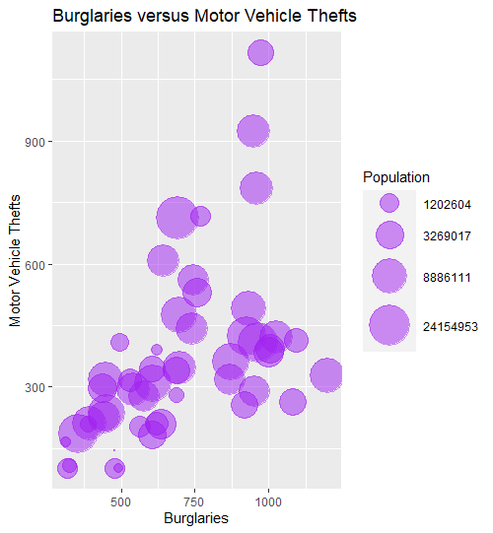
R – Bubble Plot

Slide 7
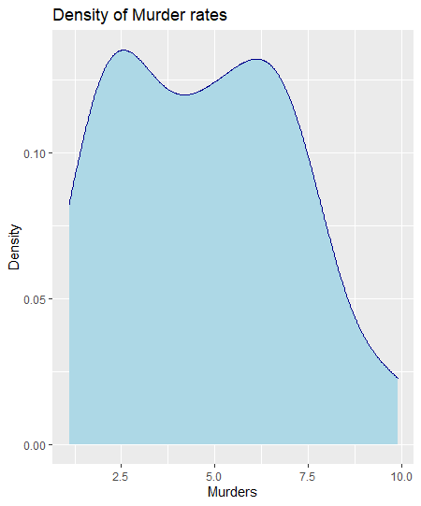
R – Density Plot

Slide 8
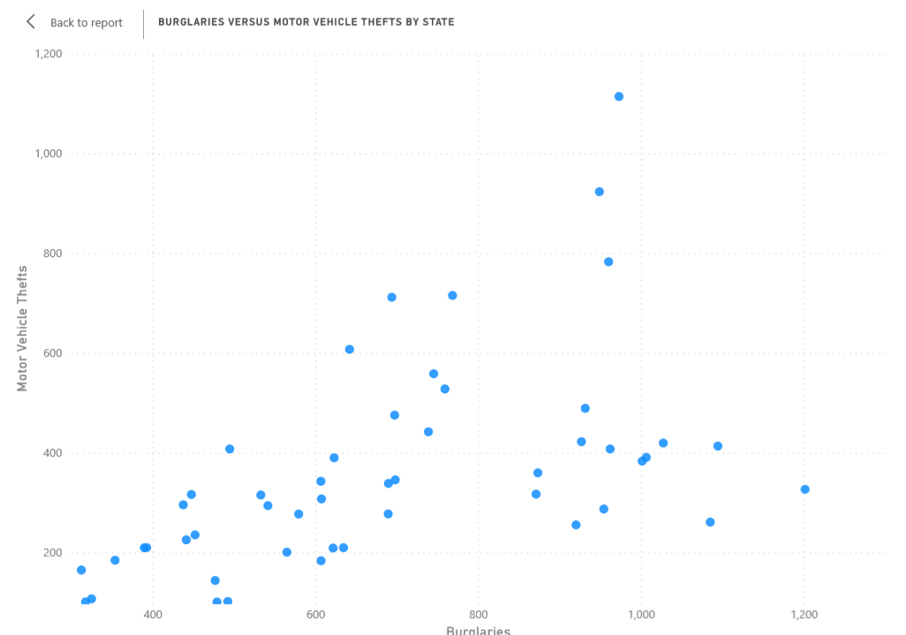
Power BI – Scatter Plot

Slide 9
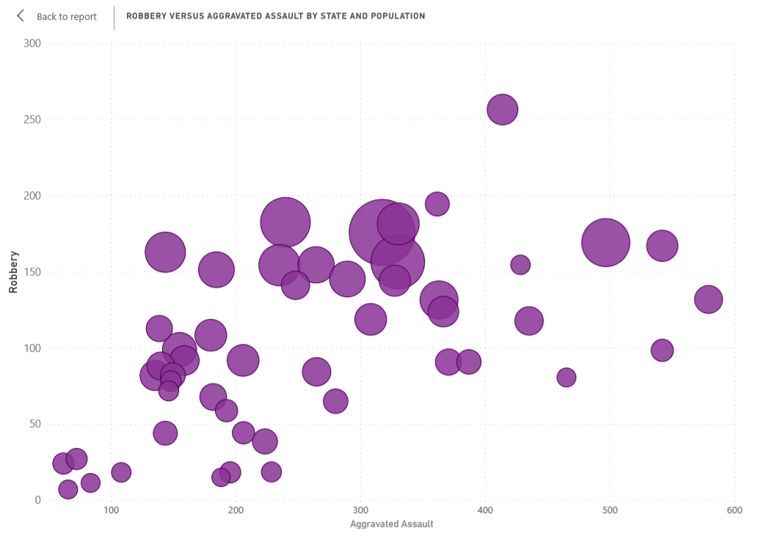
Power BI – Bubble Plot

Slide 10
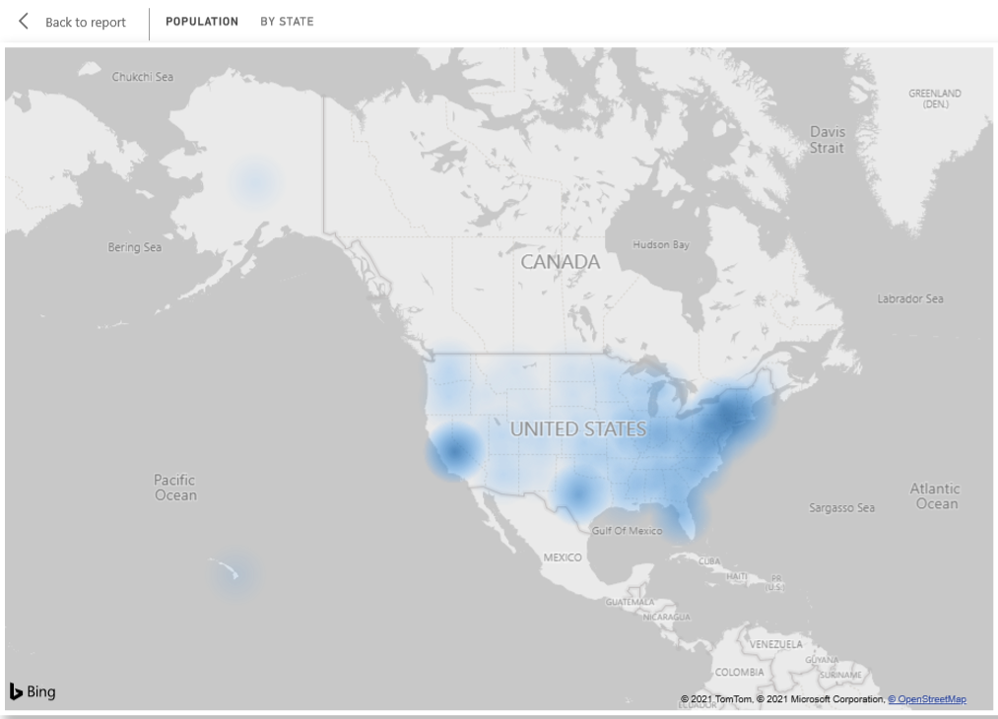
Power BI – Density Map

Slide 11
References
Data downloaded from zip file provided for this week's exercise
Python scatter plot reference - https://jakevdp.github.io/PythonDataScienceHandbook/04.02-simple-scatter-plots.html
Python bubble plot reference - https://plotly.com/python/bubble-charts/
Python density plot reference - https://seaborn.pydata.org/generated/seaborn.kdeplot.html
R scatter plot reference - https://plotly.com/r/line-and-scatter/#basic-scatter-plot
R bubble plot reference - https://www.rdocumentation.org/packages/sp/versions/1.4-5/topics/bubble
R density plot reference - http://www.sthda.com/english/wiki/ggplot2-density-plot-quick-start-guide-r-software-and-data-visualization

